Slide 1
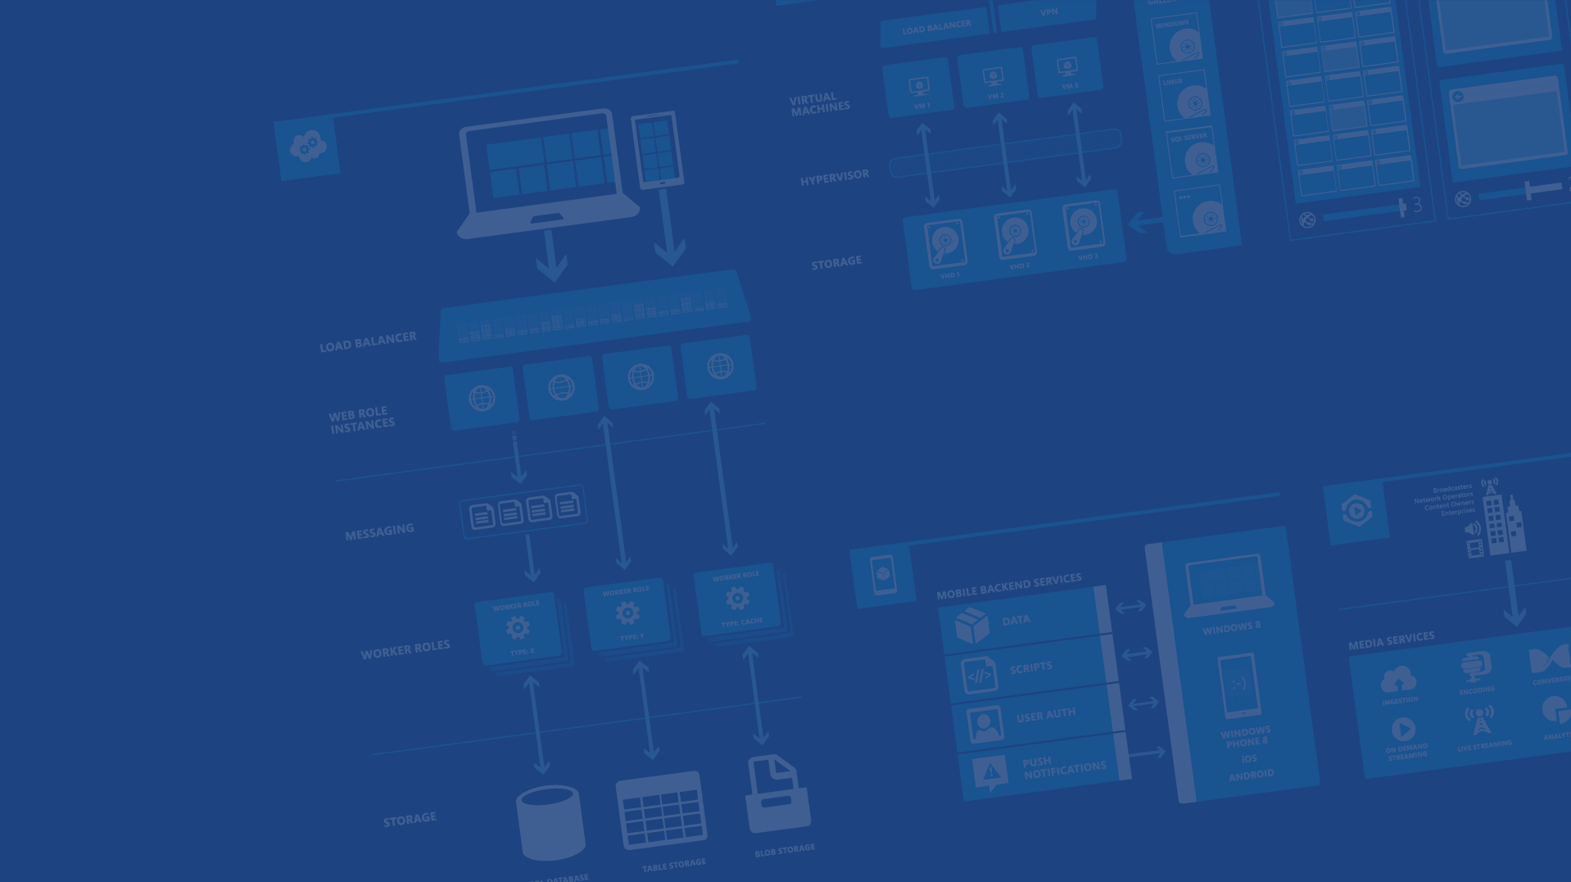
Build end-to-end video experiences with Azure Media Services
<Presenter Name>
<Presenter Title>
<company / contact info>
Microsoft Azure

Slide 2
Abstract:
Azure Media Services is a platform-as-a-service that enables you to build customizable media workflow; you could upload, encode, encrypt, package, and deliver video content to multiple platforms and devices. In this session, see how to consume various services using the Media Services client SDK. We focus on some new features, such as secure delivery options, live streaming, and more.
For video recording of this deck please see: http://channel9.msdn.com/Events/Build/2014/3-610
For Demo source please see:
mingfeiy.com

Slide 3
Agenda
→ What is Azure Media Services
→ Architecture and Features
→ Video-on-demand service including Dynamic
packaging and secure delivery
→ Live Streaming service

Slide 4
Video contributes to 57% of internet traffic

Slide 5
Everyone can create videos

Slide 6



Long form content over IP delivery

Slide 7



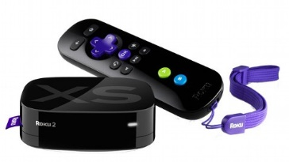



2013
Traditional TV
152 million
Connected TV
75 million
Streaming gadget
30 million

Slide 8
Viewers who consume on 4 devices WATCH 42% MORE television than those who only watch TV only
More Screens = More Viewership

Slide 9




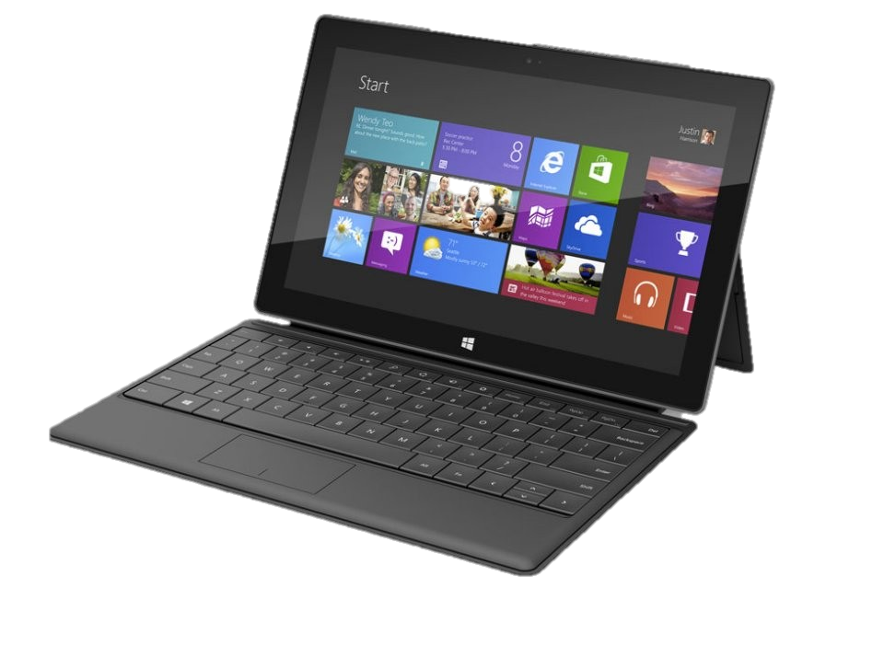
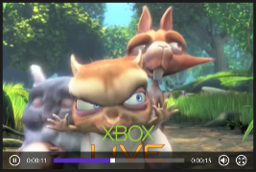





Challenges
Infrastructure costs
Managing costs
Monetizing contents
Digital Rights Management
Security
High Quality videos for any device
Anywhere and Anytime
Agile, Scalable,
Cost-Effective
Multiple formats, multiple bitrates

Slide 10
What is Microsoft Azure Media Services?

Slide 11

















Media Services Architecture
Client Libraries
“Build-On” Media Partners and Customers
Partner CDNs
REST APIs
iOS
Media Services
XBOX
Secure
Media Ingest
Encoding
On-Demand
Origin
Live Ingest
Live Origin
Advertising
HTML 5
Media Job
Scheduling
Static/Dynamic Packaging
Content Protection
Live Encoding
Analytics
Identity Management
Windows
Phone
Azure CDN
Android
Partner Technologies (Media Processors, Origin Servers, Live Encoders etc.)
Flash
Microsoft Azure (Fabric, Storage, Compute, Database)
Origin
Adaptive Streaming
Porting Kits
Caching
Released
Coming Soon
Partners

Slide 12

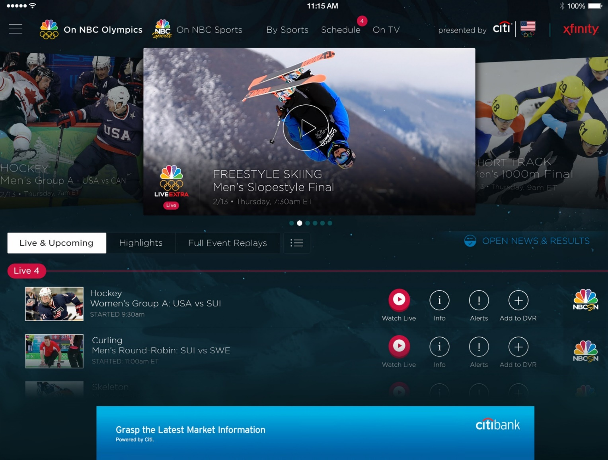
Olympics NBC Sports
Live video encoding and streaming
Web + Mobile
100 million viewers
2.1 million concurrent HD viewers during the USA vs. Canada hockey match
Notes:
Points to land:
Scale
Global
Etc.
→ Sochi website - # of requests per blah, # of cores, did not go down
→ Streaming

Slide 13






Video-on-demand Services
Ingest
Encode
Package
Encrypt
Deliver

Slide 14


Step 1: Ingest Content
ASSET
INGEST
Azure Blob
Different options of Ingesting a Mezzanine Asset
Pre-encrypt files prior to uploading (AES 256)
Secure HTTPS upload
Network level peering for fast HTTP into Azure
Fast upload using UDP with Aspera
Multiple storage accounts enabled to manage your media asset

Slide 15

Step 2: Encode, Package or Encrypt
Queue
Encode
Azure Blob
Azure Blob

Slide 16

Step 2: Encode, Package or Encrypt
Encoding Reserved Units
Encode
Encode
Azure Blob
Azure Blob
Encode
Windows Azure Media Encoder
Supports encoding to H.264 or VC-1 video
Encodes audio to AAC-LC, HE-AAC, Dolby DD+, WMA
Packages to MP4, Smooth Streaming, Http-Live-Streaming
Encrypts with PlayReady, Common Encryption, AES
Encoding with third-parties
Partner SDK for enabling ‘build-in’ encoders

Slide 17


Step 3: Deliver Content
Asset
Encode
Stream
Ingest
Azure Blob
Origin Server
Managed streaming service… it just works!
Guaranteed bandwidth
Auto recovery, redundancy and failover
Multiple origins support and scale independently
Azure and 3rd party CDN support
IP Whitelisting

Slide 18
Pricing and SLA
Encoding Service | Free Trial (3mths) | Shared | Reserved
Encoding Price | Free (100GB limit) | $1.99 Per GB | $1.99 Per GB + $99 per month/RU
Encoding SLA | NA | Availability = 99.9% Measured as REST API availability No guarantee on wait time between tasks | Availability = 99.9% Measured as REST API availability Media tasks running concurrently = Number of reserved units
Streaming Service | Free Trial (3mths) | Shared | Reserved
Streaming Price | Free (100GB limit) | Standard Egress Rates | Standard egress rates + $199 per month
Streaming SLA | NA | Availability = NA No bandwidth guarantee | Availability = 99.9% Measured as server availability based on response time Peak bandwidth of 200 Mbps per Reserved Unit allocated for Origin
For more information, please refer to Windows Azure Media Services Pricing Details

Slide 19
Microsoft Azure portal for Media Services
Demo: Azure Media Services workflow
Notes:
See /Demo1 folder from readiness kit for steps of this demo.
To watch a recorded version of this demo see http://channel9.msdn.com/Events/Build/2014/3-610?#time=9m24s
Upload, encode and playback in portal
1. In the management portal show the +New entrypoint for creating media services
2. Flip to existing media services instance
3. Click into the media service, select the content Tab
4. Press Upload in the command bar
5. Select a file and click ok
6. Once source video is uploaded, click encode in the command bar
7. Select Preset drop down Playback via HTML5 (IE/Chrome/Safari)
8. Once encoding job is done, click Publish in the command bar
9. Once published click Play in the command ba

Slide 20
Media Services APIs and SDKs 1/2
REST API for all platforms
Reference: http://msdn.microsoft.com/en-us/library/windowsazure/hh973617.aspx
.NET library
Nuget package: https://nuget.org/packages/windowsazure.mediaservices
GitHub: https://github.com/Azure/azure-sdk-for-media-services
Extensions for .NET SDK: https://github.com/sazure/azure-sdk-for-media-services-extensions
PHP Library (Just Released!)
GitHub: https://github.com/windowsazure/azure-sdk-for-php
Open Tech blog with demo: http://msopentech.com/blog/2014/01/23/ms-open-technologies-enhances-open-source-php-sdk-windows-azure/

Slide 21

Media Services APIs and SDKs 2/2
JAVA library
Windows / Mac / Linux: http://www.windowsazure.com/en-us/develop/java/java-home
GitHub: https://github.com/windowsazure/azure-sdk-for-java/
PowerShell cmdlets
How to use: http://www.gtrifonov.com/2013/08/24/how-to-use-windows-azure-powershell-for-media-services/
Node.js library
GitHub: https://github.com/fritzy/node-azure-media

Slide 22
Feature highlight - Dynamic Packaging

Slide 23







Feature highlight- Dynamic packaging Allows you to re-use your encoded content and bring it to various streaming formats without repackaging the content.
Traditional Encode and Package
Package
HLS
Encode
Package
Video sources
Multi-bitrates Mp4
Smooth
Streaming
Origin Server
Dynamic Packaging
Origin Server
Dynamic
Packaging
Encode
HLS
Smooth
Streaming
Video sources
Multi-bitrates Mp4
DASH
Input format: Mp4 or Smooth Streaming
Output format: Smooth Streaming , Http-Live-Streaming (v4 and v3), MPEG-DASH
You need to have at least 1 reserved streaming unit to enable dynamic packaging!

Slide 24
Dynamic packaging using .NET SDK extension for Media Services
Demo: How to use dynamic packaging feature to produce SS, HLS and DASH content
Notes:
This demo is available in the /Demo2 folder of the readiness kit.
1. Pre-reqs: Follow steps in top of program.cs
2. Delivery Refer to recorded version of demo - http://channel9.msdn.com/Events/Build/2014/3-610?#time=15m34s
3. Note: Instead of using the custom website player. once encoding and publish is done you can watch the video directly from within the portal on the Content Tab click play

Slide 25
Useful information - Dynamic Packaging
Full demo code at:
Introducing Extensions for Windows Azure Media Services .NET SDK
Demo – how to create HLS and Smooth Streaming assets using dynamic packaging By Mingfei Yan
Other readings:
Dynamic packaging and Encoding and Reserved units By Nick Drouin

Slide 26
Securing your media
options with Azure Media Services

Slide 27






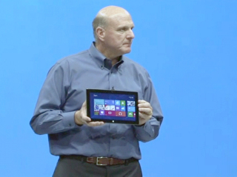

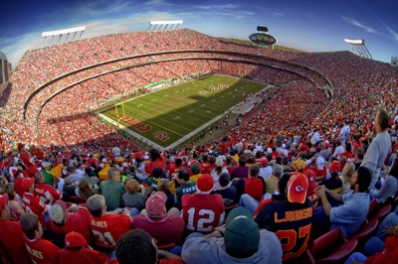

Why do you need to secure your content
Subscription Fee
(User Authentication)
High-premium content provider:
Prevent piracy
Prevent Man-in-the-middle
Ad-funded
(Player Authentication)
Employee only
Enterprise or Time-sensitive event:
Piracy is not a major issue
Prevent Man-in-the-middle
Ad-funded
(Player Authentication)

Slide 28

Options with Media Services
Prevent “man-in-the-middle”
Encrypted
Encrypted
Encrypted
Encrypted
Encrypted
Encrypted
Encrypted
AES clear key
dynamic encryption
DRM technology
+ licensing agreement

Slide 29
Options with Media Services
AES Clear Key dynamic encryption
Encrypt on-the-wire communication using the widely-known symmetric AES encryption algorithm.
An authentication service for key is provided.
DRM technology (PlayReady)
Encrypt Smooth Streaming content with PlayReady protection via common encryption scheme (CENC), and the option of packaging it into HLS or DASH.
DRM technology allows you to define restrictive licensing agreement to manage user access rights to your media.
Who should use this feature:
“Trust your client”: Key is stored in clear format so it requires you to trust your client not to pass key around
“Light” encryption: prevent “man-in-the-middle” attack
Lower cost compared to DRM solution
Who should use this feature:
Premium content or high business impact content: decoding happens in a secure DRM decoder environment
Prevent piracy and “man-in-the-middle” attack
More business models enabled

Slide 30


Architecture: AES Dynamic Encryption
Define:
Asset Delivery Policy: Dynamic Encryption
Content Key
Content Key Authorization policy
Token/IP/Open
Customers
Origin Server
Storage
HLS + AES (http)
MP4
Smooth Streaming + AES (http)
MAMS - Key Services
Request Key with token (https)
Client SDK
Return key if token verified(https)
Login
Token
verification
AES Key
Issue token
Customer’s Authz system

Slide 31
Secure Delivery features – AES dynamic encryption
Service:
Enabled through dynamic encryption feature – only keep a copy of multi-bitrates Mp4/smooth streaming, and generate encrypted Http-live-streaming or Smooth streaming on the fly
Key services to client with token-authentication, currently only Simple Web Token(SWT) is supported
Client:
Windows 8 cache plugin to decrypt AES encrypted smooth streaming
iOS SDK sample code to decrypt AES encrypted HLS stream
Flash OSMF plugin to decrypt AES encrypted smooth streaming
*Require “trust client”: key is stored by client in clear format
Future Plan:
Optional Storage decryption
DASH encrypted stream
Currently in private preview
Notes:
Review placement and content depth

Slide 32



Architecture: PlayReady DRM solution
Pre-encrypted PlayReady file:
License Acquisition URL
Key ID
Content key
Customers
Origin Server
Storage
PlayReady + Smooth Streaming
Request license
Client SDK
+
PlayReady SDK
Return license
PlayReady server

Slide 33
Demo: Protecting Smooth Streaming and MPEG DASH with PlayReady
Add steps for where to set breakpoints, and what to call out, screenshot slides hidden of what should have happened
Notes:
http://msdn.microsoft.com/en-us/library/dn189154.aspx

Slide 34
Useful information – Secure delivery
Overview:
Secure your media with Azure Media Services via MSDN
Protecting Smooth Streaming and MPEG DASH with PlayReady via MSDN
How to Protect an asset with PlayReady protection via MSDN
Session video:
Introducing the New Office 365 Video Experience
How to join AES encryption private preview:
Email yanmf@Microsoft.com

Slide 35
Why do you need to secure your content
Subscription Fee
(User Authentication)
High-premium content provider:
Prevent piracy
Prevent Man-in-the middle
Ad-funded
(Player Authentication)
DRM
Employee only
Enterprise or Time-sensitive event:
Piracy is not a major issue
Prevent Man-in-the middle
Ad-funded
(Player Authentication)
AES

Slide 36

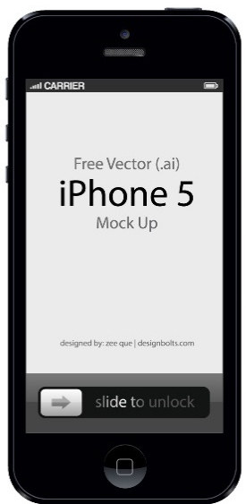
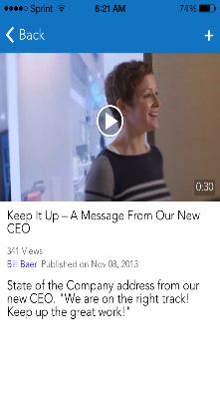
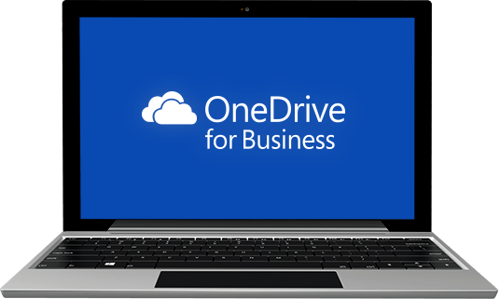
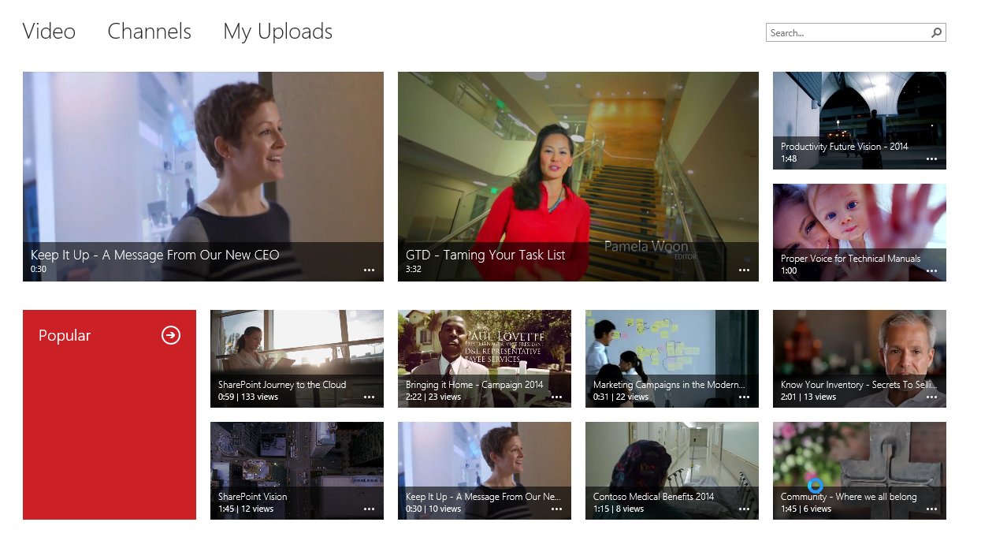

Video for Office 365
simple | fast | mobile | secure
Secure, cloud-based video upload, storage and optimized playback for the enterprise
Create, manage and subscribe to various channels
Capture, share and discover from any device
powered by Azure Media Services

Slide 37













Microsoft
Azure Media
Powered By
Services
Your
Organization

Slide 38
Live Streaming

Slide 39

Media Services Live
Stream live content directly through public cloud
Multi-format output (Smooth Streaming, HLS and DASH)
Global reach – deploy anywhere quickly
Cloud elasticity
No capital expenses
Ramp quickly to global scale
Tear down immediately
Private preview with more than 70 customers
Apply via aks.ms/wamslive to get access

Slide 40
How does live streaming work?
Ingest:
Ingest URL to accept Live streams with different bitrates (smooth streaming) through load balancer
Forwards the stream to all preview end-points
Azure Load Balancer
Channel
INGEST
Preview:
Receives stream from Ingest
Forwards to Program
Exposes Preview URL (for monitoring and voice-over)
PREVIEW
Preview URL
PROGRAM
Program:
Writes it to Blob Storage for Live DVR and Archive
Dynamic package into HLS, Smooth and DASH
PROGRAM
Program URL
Blob Storage

Slide 41




Live Streaming demo
Media Services
Ingest URL
Program URL
Notes:
Hide slide.

Slide 42
Try out Microsoft Azure Media Services www.windowsazure.com/media
Microsoft Azure Media Services accounts are Free for 90 days
Ask questions on our public forum.
http://social.msdn.microsoft.com/Forums/en-US/MediaServices
All presentation demo code is published at mingfeiy.com
Ask Questions
Mingfei Yan: yanmf@Microsoft.com Twitter: @mingfeiy
Notes:
Update Q&A

Slide 43
Q&A

Slide 44




Thanks!
We are done now.

Slide 46
16 regions worldwide in 2014
Azure footprint

Slide 47
>57%
Greater than
1,000,000
>250k
Fortune 500 using Azure
Active websites
SQL Databases in Azure
>20
>1
TRILLION storage objects
>300
MILLION
AD users
MILLION
Developers registered with Visual Studio Online
>2
MILLION requests/sec
>13
BILLION
authentication/wk

Slide 48


Slide 49

Get started
Visit azure.microsoft.com

